Slide 1
Week 9 lec 1
Function overriding

Slide 2
Method Overriding in C++
If we inherit a class into the derived class and provide a definition for one of the base class's function again inside the derived class, then that function is said to be overridden, and this mechanism is called Function Overriding

Slide 3
Requirements for Overriding a Function
Inheritance should be there. Function overriding cannot be done within a class. For this we require a derived class and a base class.
Function that is redefined must have exactly the same declaration in both base and derived class, that means same name, same return type and same parameter list.

Slide 4
Early binding
class A {
public:
void display() {
cout<<"Base class"; } };
class B:public A {
public:
int display() {
cout<<"Derived Class";
return 1; } };
int main() {
B obj;
obj.display();
return 0; }

Slide 5
Early binding
In the above example, we are calling the overridden function using derived class object. Compiler gives preference to object type.
Base class object will call base version of the function and derived class's object will call the derived version of the function. This is called early binding
In early binding return type is ignored

Slide 6
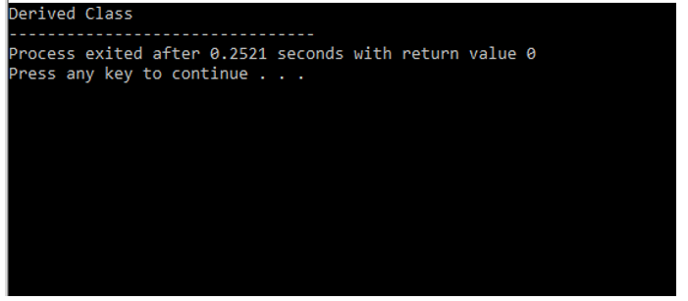
Early binding

Slide 7
Function Call Binding with class Objects
Connecting the function call to the function body is called Binding. When it is done before the program is run, its called Early Binding or Static Binding or Compile-time Binding.

Slide 8
Return type is not same
class Base {
public:
void print() {
cout << "base class print()" << endl; }};
class Derived : public Base {
public:
int print() {
cout << "derived class print()" << endl;
return 1;}
};
int main() {
Derived derived1;
derived1.print();}

Slide 9
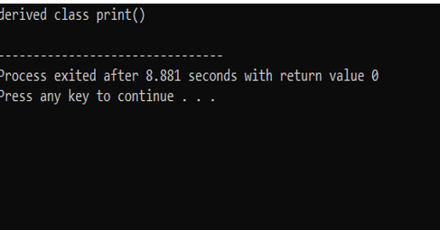
In early binding return type ignored

Slide 10
Can we overload methods in sub class?
Can we overload methods in sub class?
Yes overloading can be done in different scopes but….

Slide 11
Can we overload methods in sub class?
C++ handles overloading across subclasses in a much different way. A member function
declaration in a derived class does not overload member functions with the same name
declared in the base class.
Rather, a member function in a derived class hides the declaration of the member functions
with the same name in base class, even though the function parameter lists are different. Hence, to have member functions from a base class overload member functions from the
derived class, the designer of the derived class can introduce the base class member
functions into the scope of the derived class with using declarations.

Slide 12
Can we overload methods in sub class?
class Check{
int i;
public:
Check(): i(0) { }
void Display()
{ cout << "i of base "<< i <<endl; }};
class Go : public Check{
int i;
public:
Go(): i(1) { }
Display(int i)
{ cout << "i of child "<< i <<endl; }};

Slide 13
Can we overload methods in sub class?
int main(){
Go g;
g.Display(3); // derived class will hide the Display() func of base class
return 0;}

Slide 14
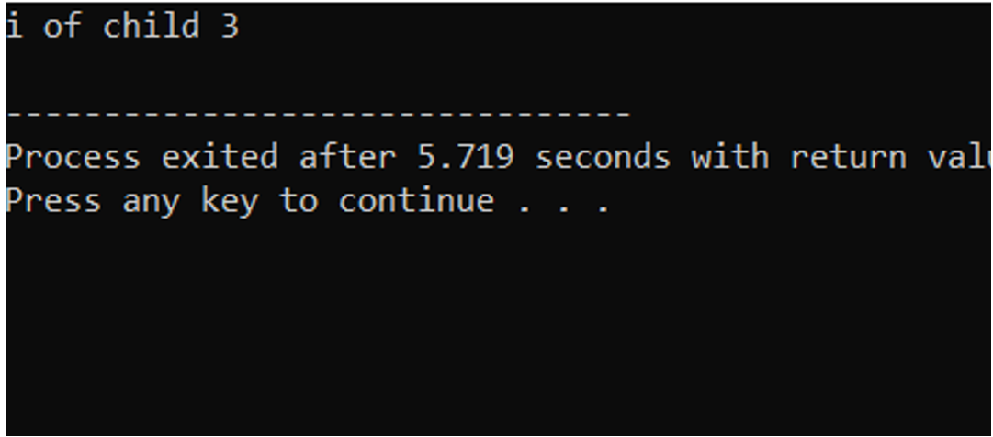

Slide 15
int main(){
Go g;
g.Display();
return 0;}

Slide 16
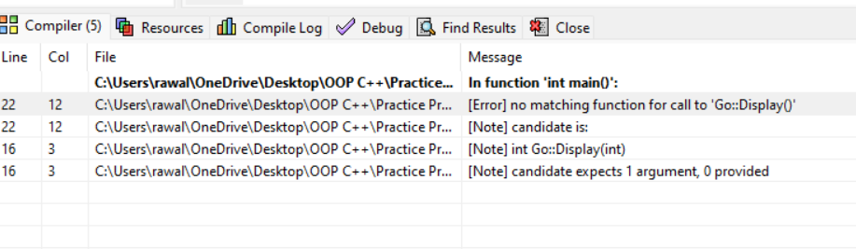
Can we overload methods in sub class?

Slide 17
overloading methods in sub class
#include <iostream>
using namespace std;
class Base{
public:
void foo(int i) {
cout << "Inside foo(int i) i= " << i << "\n"; }};
class Derived : public Base{
public:
// using Base::foo; must be added
// in absence of this simply foo(float f) is called
// in its presence foo(int i) is called, no ambguity
Base::foo;
void foo(float f) {
cout << "Inside foo(float f) f= " << f << "\n"; }};

Slide 18
overloading methods in sub class
int main(){
float f = 1.2f;
int i = 100;
Derived obj;
obj.foo(i); //no compiler error base foo
obj.foo(f); //no compiler error derived foo
}
Notes:
#include <iostream>using namespace std;class A{ public: void foo(){cout<<"from parent class"<<endl;}};class B:public A{ public: A::foo; void foo(){ cout<<"child class call"<<endl;}};int main(){ B b1; b1.foo(); return 0;}

Slide 19
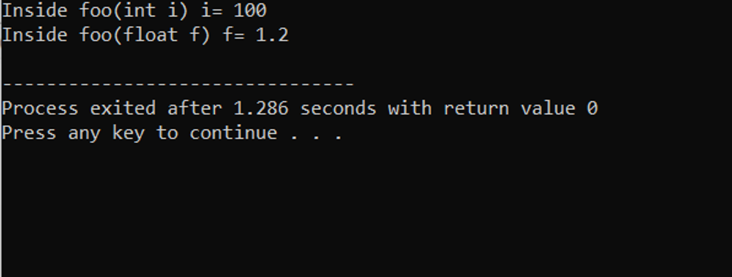
overloading methods in sub class

Slide 20
overloading methods in sub class
The code using Base::foo; makes all the functions named foo (irrespective of their
arguments) from base class directly accessible in the Derived class. Hence the functions
named foo become overloaded in the scope of Derived class. In case of multiple foo
functions in the base class, it is not possible to make only a few "foo" functions from
the base class accessible in the derived class with "Base::foo; " declaration. Since both versions of foo are available in the scope of Derived class, the compiler can
choose specific function from them without any ambiguity here, and the call foo(i) is
correctly resolved to foo(int t).

Slide 21
multiple foo functions in the base class
class Base{
public:
void foo(int i) {
cout << "Inside foo(int i) i= " << i << "\n"; }
void foo() {
cout << "Inside foo(default) " << "\n"; }};
class Derived : public Base{
public:
Base::foo;
void foo(float f) {
cout << "Inside foo(float f) f= " << f << "\n"; }};

Slide 22
multiple foo functions in the base class
int main(){
float f = 1.2f;
int i = 100;
Derived obj;
obj.foo(i);
obj.foo(); //no compiler error
}

Slide 23
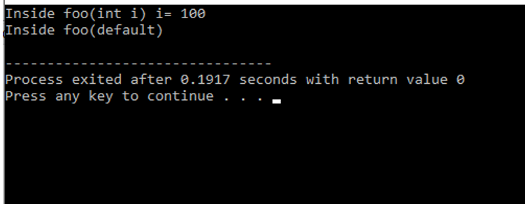
multiple foo functions in the base class

Slide 24
Function Overloading VS Function Overriding
Inheritance: Overriding of functions occurs when one class is inherited from another class. Overloading can occur without inheritance.
Function Signature: Overloaded functions must differ in function signature ie either number of parameters or type of parameters should differ. In overriding, function signatures must be same.
Scope of functions: Overridden functions are in different scopes; whereas overloaded functions are in same scope.
Behavior of functions: Overriding is needed when derived class function has to do some added or different job than the base class function. Overloading is used to have same name functions which behave differently depending upon parameters passed to them.

Slide 25
Week 10 Lecture 1
Runtime Polymorphism

Slide 26
Compile-time(early binding)
class Base {
public:
void print() {
cout << "base class print()" << endl; }};
class Derived : public Base {
public:
void print() {
cout << "derived class print()" << endl;}};
int main() {
Derived derived1;
Base* base1 ;
base1= &derived1;
base1->print();}

Slide 27
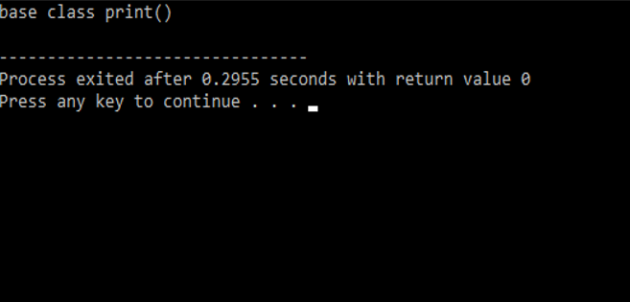
Compile-time(early binding)

Slide 28
Problem
In the above example, although, the object is of Derived class, still Base class's method is called. This happens due to Early Binding.
Compiler on seeing Base class's pointer, set call to Base class’s print() function, without knowing the actual object type.
Solution
Virtual Function is a function in base class, which is override in the derived class, and which tells the compiler to perform Late Binding on this function.
Virtual Keyword is used to make a member function of the base class Virtual.

Slide 29
virtual function
A virtual function is a member function that you expect to be redefined in derived classes. When you refer to a derived class object using a pointer or a reference to the base class, you can call a virtual function for that object and execute the derived class's version of the function.
Virtual functions ensure that the correct function is called for an object, regardless of the expression used to make the function call.

Slide 30
virtual function
They are mainly used to achieve Runtime polymorphism
Functions are declared with a virtual keyword in base class.
The resolving of function call is done at Run-time.

Slide 31
Late Binding in C++
In Late Binding function call is resolved at runtime. Hence, now compiler determines the type of object at runtime, and then binds the function call. Late Binding is also called Dynamic Binding or Runtime Binding.

Slide 32
virtual function
class Base {
public:
virtual void print() {
cout << "base class print()" << endl; }};
class Derived : public Base {
public:
void print() {
cout << "derived class print()" << endl;}};
int main() {
Derived derived1;
Base* base1 ;
base1= &derived1;
base1->print();}

Slide 33
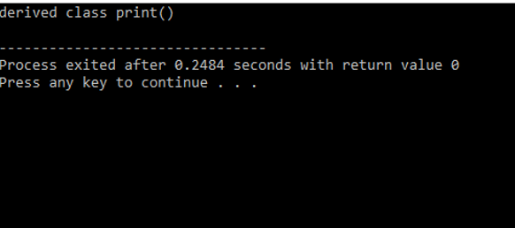
virtual function

Slide 34
Runtime Polymorphism.
Runtime polymorphism is achieved only through a pointer (or reference) of base class type
Late binding(Runtime) is done in accordance with the content of pointer (i.e. location pointed to by pointer) and Early binding(Compile time) is done according to the type of pointer

Slide 35
When calling a function using pointers or references, the following rules apply:
Functions in derived classes override virtual functions in base classes only if their type is the same. A function in a derived class cannot differ from a virtual function in a base class in its return type only; the argument list must differ as well.
A call to a virtual function is resolved according to the underlying type of object for which it is called.
The virtual keyword can be used when declaring overriding functions in a derived class, but it is unnecessary; overrides of virtual functions are always virtual.

Slide 36
Rule 3
class Base {
public:
virtual void print() {
cout << "base class print()" << endl; }};
class Derived : public Base {
public:
virtual void print() { // virtual keyword with derived version can be used
cout << "derived class print()" << endl;}};
int main() {
Derived derived1;
Base* base1 = &derived1;
base1->print();}

Slide 37
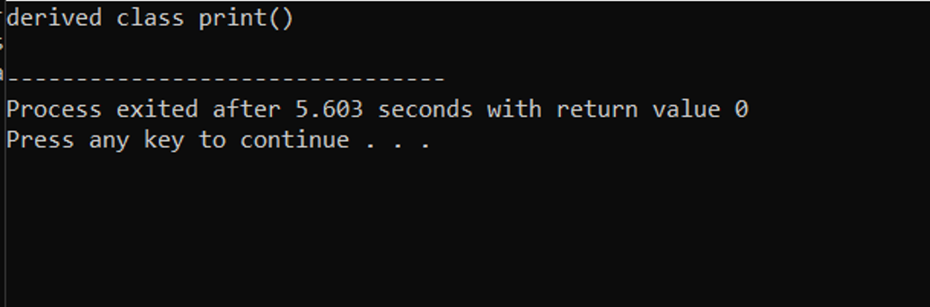

Slide 38
Working of virtual functions(concept of VTABLE and VPTR)
If a class contains a virtual function, then compiler itself does two things:
vtable: A table of function pointers, maintained per class.
It is a table that contains the memory addresses of all virtual functions(only VFs) of a class in the order in which they are declared in a class. This table is used to resolve function calls in dynamic/late binding manner. Every class that has virtual function will get its own Vtable.

Slide 39
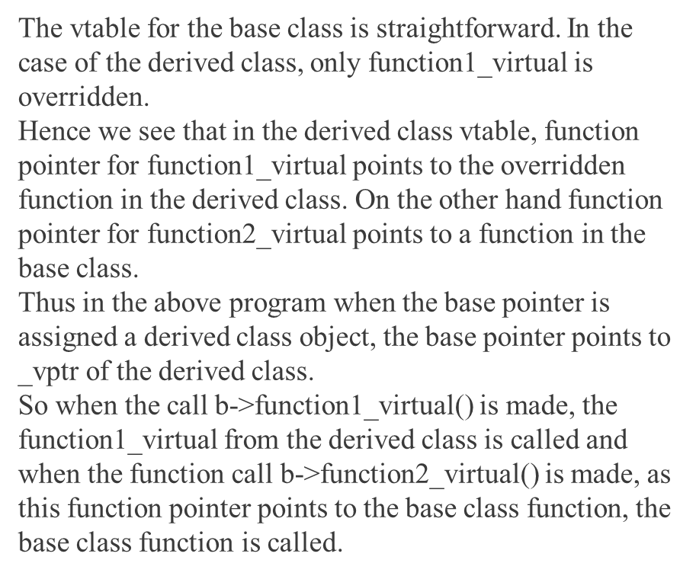
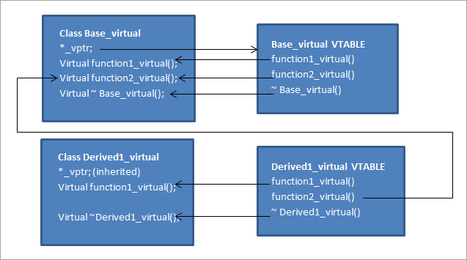

Slide 40
Working of virtual functions(concept of VTABLE and VPTR)
2. vptr: A pointer to vtable, maintained per object instance.
After creating Vtable address of that table gets stored inside a pointer i.e. VPTR (Virtual Pointer). When you create an object of a class which contains virtual function then a hidden pointer gets created automatically in that object by the compiler. That pointer points to a virtual table of that particular class.

Slide 41
Derived-Class Member-Function Calls via Base-Class Pointers
class Base {
public:
virtual void print() {
cout << "base class print()" << endl; }};
class Derived : public Base {
public:
void print() {
cout << "derived class print()" << endl;}
void show() {
cout << "only derived class member function" << endl;}};
int main() {
Derived derived1;
Base* base1 = &derived1;
base1->print();
base1->show();}

Slide 42
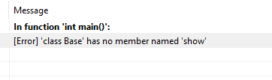
Derived-Class Member-Function Calls via Base-Class Pointers

Slide 43
Question ??
Can I override static function C++?

Slide 44
Can I override static function C++?
Static methods cannot be overridden because method overriding only occurs in the context of dynamic (i.e. runtime) lookup of methods. Static methods (by their name) are looked up statically (i.e. at compile-time).

Slide 45
Early binding
#include <iostream>
using namespace std;
class base{
public:
static void func(){
cout << "inside base"<< endl; }};
class child:public base{
public:
void func(){
cout << "inside child"<< endl; }};
int main(){
base* b ;
child c;
b = &c;
b -> func();
}

Slide 46
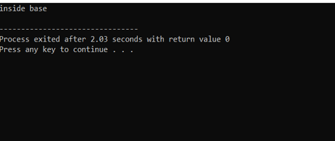
Early binding

Slide 47
Static in run time polymorphism
#include <iostream>
using namespace std;
class base{
public:
virtual static void func(){
cout << "inside base"<< endl; }};
class child:public base{
public:
void func(){
cout << "inside child"<< endl; }};
int main(){
base* b ;
child c;
b = &c;
b -> func();
}

Slide 48
Important point
A derived class virtual function is only considered overridden if its signature and return type must match exactly

Slide 49
A derived class virtual function is only considered overridden if its signature and return type must match exactly
class Base {
public:
virtual void print() {
cout << "base class print()" << endl; }};
class Derived : public Base {
public:
int print() {
cout << "derived class print()" << endl;
return 1;}
};
int main() {
Derived derived1;
Base* base1 = &derived1 ; //up casting
base1->print();
}

Slide 50
#include <iostream>
using namespace std;
class Base {
public:
virtual void print() const{
cout << "base class print()" << endl; }};
class Derived : public Base {
public:
void print() {
cout << "derived class print()" << endl;
}
};
int main() {
const Derived derived1;
derived1.print();
}

Slide 51
Question ???
can we override const method with non const in c++

Slide 52
It is neither overloading nor overriding. Rather, it is hiding.
const is part of the signature, and leaving it off changes the signature, and thus hides the method rather than overrides it. "

Slide 53
class Base {
public:
virtual void print() const{
cout << "base class print()" << endl; }};
class Derived : public Base {
public:
void print() {
cout << "derived class print()" << endl;
}
};
int main() {
Derived derived1;
Base* base1 = &derived1 ;
base1->print();
}

Slide 54
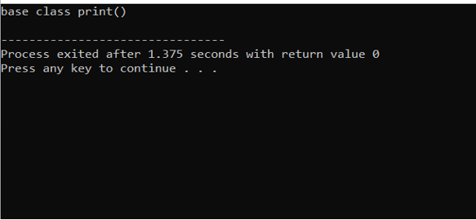

Slide 55
How to prevent class inheritance and method overriding in C++
Use of final specifier in C++ 11:

Slide 56
uses final specifier after the function parameter list to prevent method overriding
class Base {
public:
virtual void print() final{
cout << "base class print()" << endl; }};
class Derived : public Base {
public:
void print() {
cout << "derived class print()" << endl; }};
int main() {
Derived derived1;
Base* base1 = &derived1 ;
base1->print();}

Slide 57
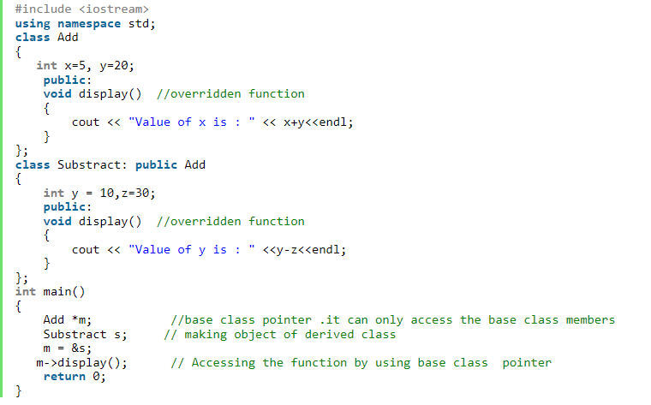
Example

Slide 58
Exercise
Create two classes named Mammals and MarineAnimals. Create another class named BlueWhale which inherits both the above classes. Now, create a function in each of these classes which prints "I am mammal", "I am a marine animal" and "I belong to both the categories: Mammals as well as Marine Animals" respectively. Now, create an object for each of the above class and try calling 1 - function of Mammals by the object of Mammal 2 - function of MarineAnimal by the object of MarineAnimal 3 - function of BlueWhale by the object of BlueWhale 4 - function of each of its parent by the object of BlueWhale
Types of Inheritance = ??
Write a Basic Sekeletone

Slide 59
Exercise
Create a base class named Person with name, age, and gender as its data members. Define a constructor to initialize the data members and a function display() to display the details of the person.
Create a derived class named Employee which inherits Person class. Define empid and salary as its data members. Define a constructor to initialize the data members and override the display() function to display the details of the employee.
Create another derived class named Manager which inherits Employee class. Define department as its data member. Define a constructor to initialize the data members and override the display() function to display the details of the manager.
Create an object for Person, Employee, and Manager classes and call their display() functions.
Types of Inheritance = ??
Write a Basic Sekeletone

Slide 60
Task
You are part of a team, developing a smart home automation system using C++. The system is
responsible for controlling various appliances in a house, including lights, thermostats. The goal is
managing these devices&#39; states and settings. For this we have base class Device and appliances lights,
thermostats are inherited from Device class.
1. Device class, it has data member isOn and deviceType(lightController or ThermostatController),
constructor which initialize isOn and deviceType(lightController or ThermostatController) variable
(values can be either true or false), method “isDeviceOn” to check which device is on or off.
2. LightController class (It manages the state of lights in different rooms). It has data member
brightness and zone (Different area of home e.g., Living Room, Kitchen, Bed Room.). The
constructor which initializes attributes brightness, zone and isOn , device type attributes via base
class constructor.

Slide 61
Cont..
Implement methods to control the lights in various ways:
a. Turn on or off a light in a specific zone (Living Room, Kitchen, Bed Room.) in the house (if isOn is
true then brightness should be 100 otherwise 0).
b. Adjust the brightness of a light in specified area of home.
c. Set a timer for a light with specified brightness level to turn it on or off for specified duration in
specific area of home.
3. ThermostatController class (It regulates the temperature of different zones (Living Room, Kitchen,
Bed Room.) in the house. It has data member temperature and zone. Constructor which initializes
temperature variable. Implement methods to control the thermostats in different ways:
a. Set the desired temperature for a specific zone (Increase or decrease the temperature for a specific
zone).
b. Schedule a temperature change at a specific time for specified duration in specific area of home.
Create objects based on given scenario.

